Slide 1
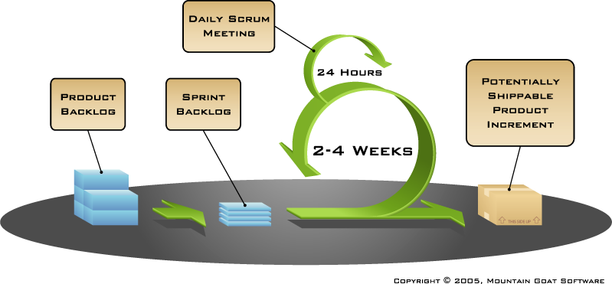
Resultate der Tasks CS1 9 und 10
Präsentation Gruppe blue
Technik und Informatik / Medizininformatik

Slide 2
Diagramme
Task 9

Slide 3
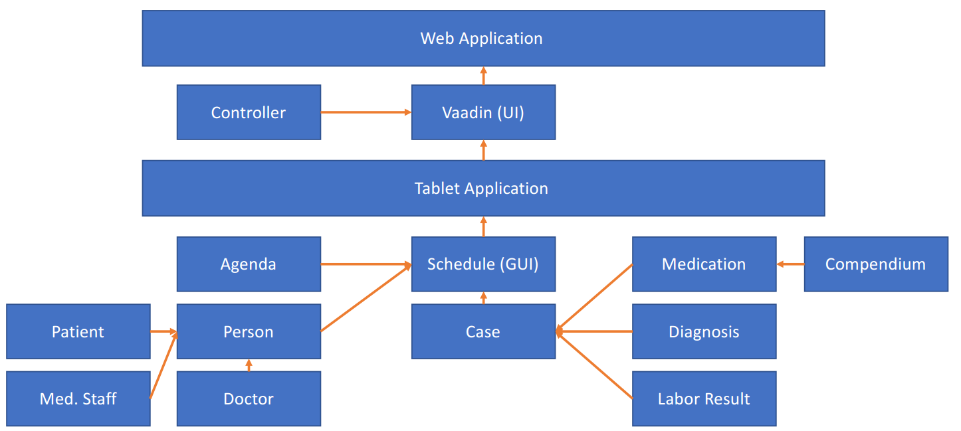
Block diagram

Slide 4
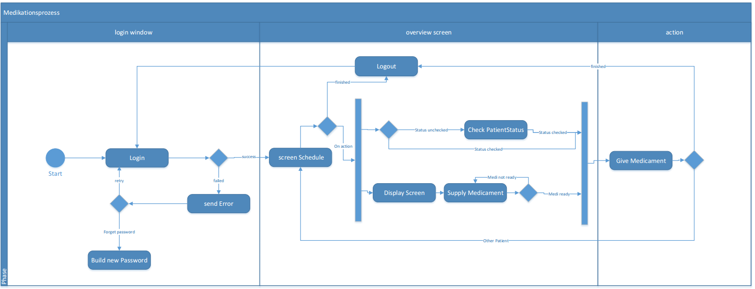
Activity diagram

Slide 5
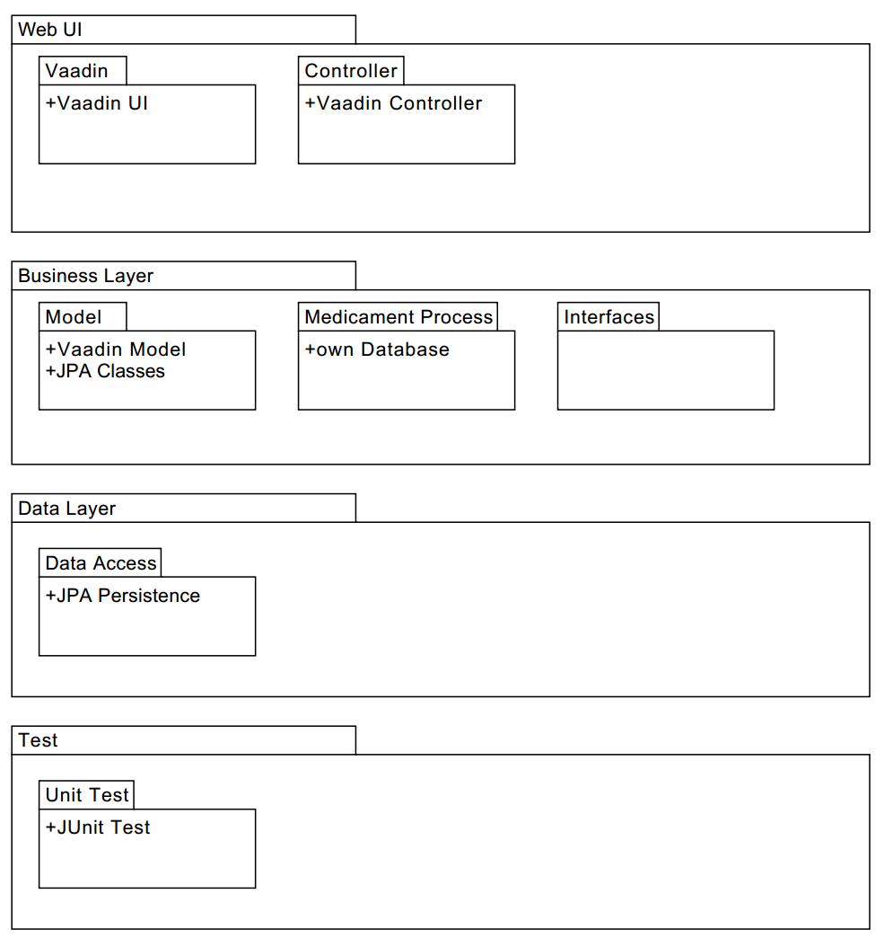
Package diagram

Slide 6
Scrum
Task 10

Slide 7
Scrum, Product Backlog
ID | Story Name | Description | Priority | Effort Plan Original
1 | Login | As a user, I want to log in with my username and password | low | 16
2 | Logout | As a user, I want to log out immediately, no matter where I am | low | 8
3 | Schedule view | As a user, I want to see all patient appointments | high | 16
4 | display information about the patient | As a user, I want to get all necessary information about a patient | high | 16
5 | display information about diagnosis | As a user, I want to see all information about patients diagnosis | medium | 12
6 | User gets past labor results from DB | As a user, I want to see past labor results | low | 12
7 | User gets standing data of patients | As a user, I want to get important information about the patients identity | high | 8
8 | status medication preparation | As a user, I want to see if I've already prepared a set of medicaments | high | 16
9 | status medications | As a user, I want to check medication | high | 16
10 | clock for schedule view | As a user, I want to see the time on the schedule view | low | 8
11 | synchronize | As a user, I want to have an option to update data | low | 16
12 | alarm | As a user, I want to inform co-workers if a patient behaves aggressively | low | 12

Slide 8
Scrum, Sprint Backlog
ID | Sprint | Name | Description | Components | Owner | Reviewer | Priority | Effort Plan Original
1.1 | 1 | Database | testdatabase, based on the uml class diagramm, filled with exampledata | Database | dittp2 | telec1 | high | 12
1.2 | 1 | Schedule UI | Schedule UI | UI, Controller | varan2 | lamlr1 | medium | 12
1.3 | 1 | Java Classes skeleton | Uml to Java classes | Controller, JPA Classes | jolop1 | kammf1 | high | 6
1.4 | 1 | Associations | Implementing Associations | Controller, JPA Classes | sevib1 | lamlr1 | high | 6
1.5 | 1 | Getter methods | JDBC - connector between DB and JVM | JPA Classes, Database | kammf1 | sevib1 | low | 6
Sprint of 2 weeks
Tot. 42

Slide 9
Scrum, Activities
Sprint planning
What is possible?
How should it be done?
Daily Scrum = twice a week à 10-15 min.
Sprint 1: 4 daily scrums
Sprint review (with scrum-owner)
Retrospective (intern)

Slide 10
Danke für Ihre Aufmerksamkeit

